Slide 1
Binomial Process
PROBABILITY AND STATISTICS

Slide 2
Binomial Distribution
A binomial experiment is one that possesses the following properties
The experiment consists of n repeated trials; A fixed number of observations (trials), n
  e.g., 15 tosses of a coin; 20 patients; 1000 people surveyed
Each trial results in an outcome that may be classified as a success or a failure (hence the name, binomial); only two outcomes

Slide 3
Binomial Distribution
The probability of a success, denoted by p, remains constant from trial to trial
Repeated trials are independent of each other
  Probability of success is p, probability of failure is q = 1 – p

Slide 4
Binomial Distribution
You flip a coin 2 times and count the number of times the coin lands on heads. This is a binomial experiment because:
The experiment consists of repeated trials – flipping a coin
Each trial can result in just two possible outcomes - heads or tails.
The probability of success is constant - 0.5 on every trial.
The trials are independent; that is, getting heads on one trial does not affect whether we get heads on other trials.

Slide 5
Binomial
Binomial: Suppose that n independent experiments, are performed, where n is a fixed number, and that each experiment results in a “success” with probability p and a “failure” with probability 1-p. The total number of successes, X, is a binomial random variable with parameters n and p.
We write: X ~ Bin (n, p) {reads: “X is distributed binomially with parameters n and p}
The probability distribution of the random variable X is called a binomial distribution

Slide 6

Binomial
The binomial probability refers to the probability that a binomial experiment results in exactly x successes.

Slide 7
Binomial Probability
n = the number of trials
x = 0, 1, 2, ... n
p = the probability of success in a single trial
q = the probability of failure in a single trial
(i.e. q = 1 − p)
_{n}C_{r}: The number of combinations of n things, taken r at a time.
_{n}C_{r} = n! / r!(n - r)!
P(X) gives the probability of successes in n binomial trials.

Slide 8
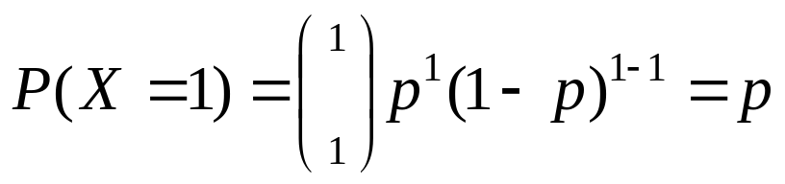
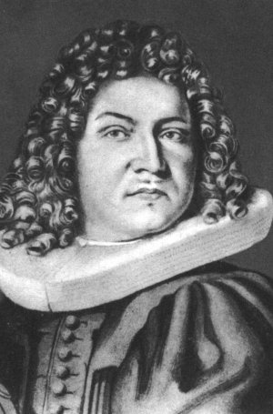
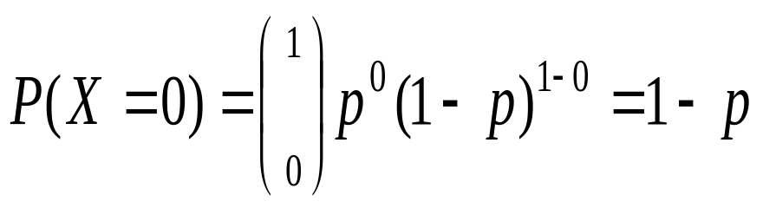
Bernoulli Trial
If there is only 1 trial with probability of success p and probability of failure 1-p, this is called a Bernouilli distribution. (special case of the binomial with n=1)
Probability of success:
Probability of failure:
James Bernoulli (Jacob I)
born in Basel, Switzerland
Dec. 27, 1654-Aug. 16, 1705

Slide 9
Binomial Probability - Example
Suppose a die is tossed 5 times. What is the probability of getting exactly 2 fours?
Solution:
Number of trials is 5
Number of successes is 2
Probability of success on a single trial is 1/6 (0.167)
Therefore, the binomial probability is:
b(2; 5, 0.167) = ₅C₂ * (0.167)² * (0.833)³
b(2; 5, 0.167) = 0.161

Slide 10
Example
A coin is thrown 10 times. X is the random variable representing the number of heads obtained. What is the probability of getting 2 heads and 8 tails?
The probability of throwing a head is ½ and the probability of throwing a tail is ½. Therefore, the probability of throwing 8 tails is (½)⁸
Hence the probability of throwing 2 heads and 8 tails is
¹⁰C₂ × (½)² × (½)⁸ .

Slide 11
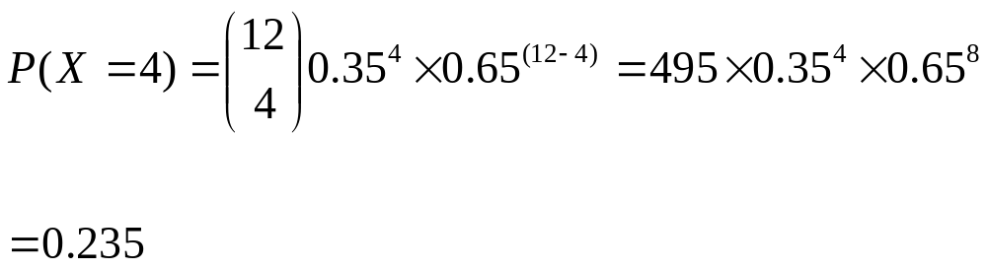
Example
Eggs are packed in boxes of 12. The probability that each egg is broken is 0.35.
Find the probability in a random box of eggs there are 4 broken eggs

Slide 12
Cumulative Binomial
A cumulative binomial probability refers to the probability that the binomial random variable falls within a specified range
For example, we might be interested in the cumulative binomial probability of obtaining 45 or fewer heads in 100 tosses of a coin
b(x<45;100,0.5) =
b(x = 0; 100, 0.5) + b(x = 1; 100, 0.5) + ... + b(x = 44; 100, 0.5) + b(x = 45; 100, 0.5)

Slide 13
Cumulative Binomial - example
You are given the following:
X = number of boys in the family.
n = 6,
p = 0.5215,
q = 1 − 0.52153 = 0.4785
What proportion of Singapore families with exactly 6 children will have at least 3 boys?

Slide 14
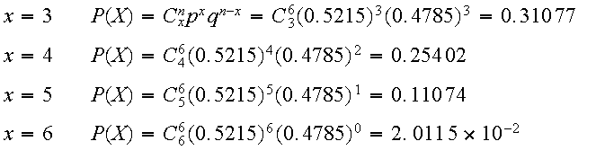
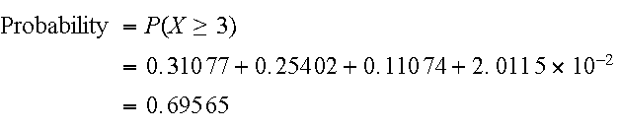
Cumulative Binomial - example
So the probability of getting at least 3 boys is:
OR

Slide 15
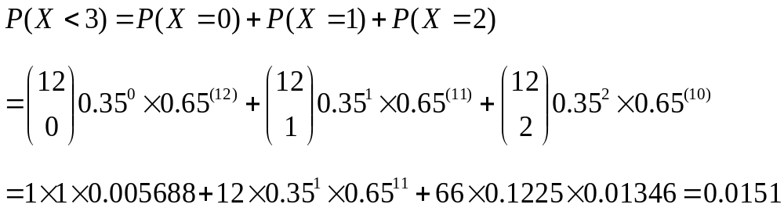
Cumulative Binomial - example
Eggs are packed in boxes of 12. The probability that each egg is broken is 0.35. Find the probability in a random box of eggs:
There are less than 3 broken eggs

Slide 16
Mean and Variance
If p is the probability of success and q is the probability of failure in a binomial trial, then the expected number of successes in n trials (i.e. the mean value of the binomial distribution) is
E(X) = μ = np
The variance of the binomial distribution is
V(X) = σ² = npq
Standard deviation is
SD (X) = √σ²

Slide 17
The End

